Slide 1
SECURECOMM
26 September 2014
Beijing Yulong International Hotel, Beijing, China
JumpBox – A Seamless Browser Proxy for Tor Pluggable Transports
Jeroen Massar, Farsight Security, Inc.
massar@fsi.io
Ian Mason, Linda Briesemeister, Vinod Yegneswaran, SRI International
{iam,linda,vinod}@csl.sri.com
IPv6 Golden Networks

Slide 2
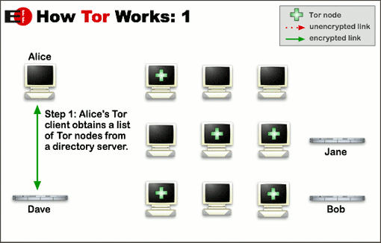
How Tor Works 1/3

Slide 3
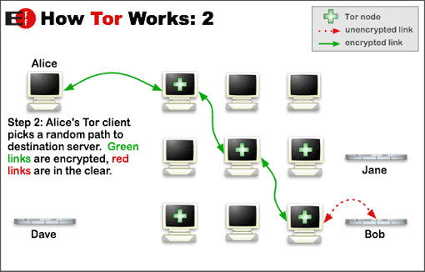
How Tor Works: 2/3

Slide 4
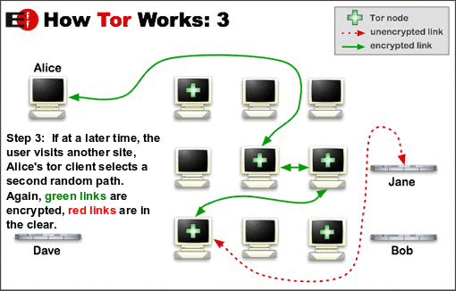
How Tor Works: 3/3

Slide 5
Where Tor gets blocked
Blocked
Networks that are hostile against Tor recognize it based on Fingerprinting the connections, IP addresses involved and other techniques

Slide 6
Pluggable Transports
Plugging
PT link
We tunnel the first connection with a Pluggable Transport, tunneling over HTTP etc.
The first Tor link goes through this connection

Slide 7
Many Pluggable Transports
Obfsproxy
Obfuscates bits of the Tor connection avoiding fingerprinting
StegoTorus
Tunnels over multiple HTTP connections using JPEG/HTML/JSON/PDF to multiple servers that merge the packets back.
FlashProxy
Uses Flash to create proxies in browsers creating random proxies
Format Transforming Encryption (FTE)
Fakes protocols by implementing them minimally using algorithms
Meek
Tunnels over HTTPS uses SSL cert from public Cloud Services
More: https://www.torproject.org/docs/pluggable-transports.html.en

Slide 8
Related circumvention systems
Non-Pluggable-Transport systems:
VPNs (OpenVPN, SSH tunnels, PPTP, AYIYA etc)
Telex, Decoy Routing and Cirripede
Use signaling inside TCP headers to circumvent filtering systems by routing them over alternate paths.
Infranet
Provides a tunnel over HTTP
Collage
Uses steganography for hiding communications inside images and other content hosted on standard webforums.

Slide 9
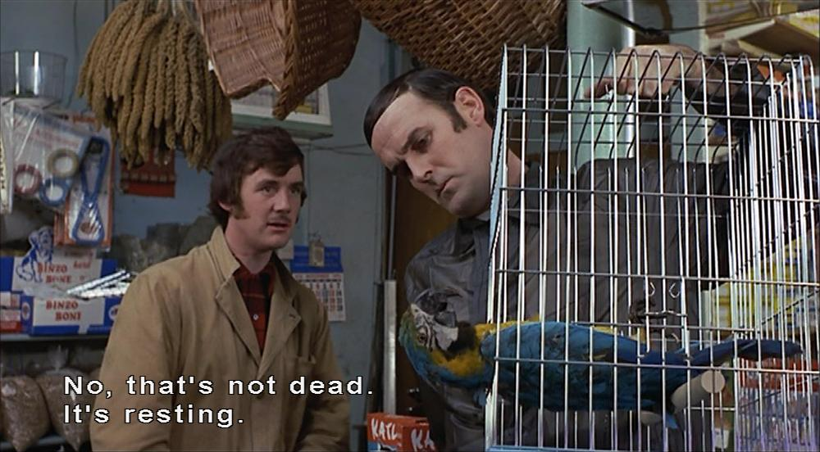
The Parrot is Dead
“The Parrot is Dead:
Observing Unobservable Network Communications”
https://www.cs.utexas.edu/~shmat/shmat_oak13parrot.pdf
Creating an own HTTP engine means that you will never match 100% what an actual browser would do.

Slide 10
Becoming a Mockingbird
Our Design Goals for JumpBox:
Be the browser
Don’t emulate, but use a real browser
Extensibility
Make it possible to easily extend the concept
Seamless integration
No code changes required to either browser or PT
Minimal overhead
The system should not impact performance

Slide 11
JumpBox Design
(client)
(bridge)
Tor network
Pluggable Transport
Client
Pluggable Transport
Server
JumpBox
Daemon
JumpBox
Plug-in
mod_jumpbox
Proxy User
Proxy Server

Slide 12
Jumping the Box
The browser plugin keeps on asking for new requests with XHR1.
When it gets one, it sends it to the PTS with XHR2
The result from the PTS is answered with XHR3

Slide 13
FTEProxy through JumpBox
Normal FTEproxy Request:
C: GET /GPcoEIlMxXBh...<base64-encoded-bytes>...LoQas HTTP/1.1
S: HTTP/1.1 200 OK
S: Content-Type: H
S:
S: ....<binary bytes>…
FTEProxy through JumpBox:
C: GET /Id5UdpnNYFB...<base64-encoded-bytes>...160VG HTTP/1.1
C: Host: example.com
C: User-Agent:
C: Connection: keep-alive
C: Accept: text/html,...,application/xml;q=0.9,image/webp,*/*;q=0.8
C: User-Agent: Mozilla/5.0 ... Chrome/34.0.1833.5 Safari/537.36
C: Referer: http://www.example.com/
C: Accept-Encoding: gzip,deflate,sdch
C: Accept-Language: en-US;q=0.8,en;q=0.2,de;q=0.2
S: HTTP/1.1 200 OK
S: Date: Thu, 01 Feb 2013 09:01:28 GMT
S: Server: Apache
S: Accept-Ranges: bytes
S: Content-Length: 2529
S: Keep-Alive: timeout=5, max=100
S: Connection: Keep-Alive
S: Content-Type: application/octets
S: Content-Language: en-GB
S:
S: ....<binary bytes>...

Slide 14
Solves HTTP mimicry problems
HTTP header inconsistencies
Case, wrong/missing CRLF, extra chars, wrong parsing
HTTP URI encodings
Hex encoding, double hex encoding, %u encoding etc
HTTP content encodings
gzip, chunked encodings etc
Timing attacks
Very difficult on the layer-7, especially as one does not know the speed of the client’s Internet connection
JumpBox uses a standard Browser (Chrome) and a normal Server (Apache), hence they handle these issues for us.

Slide 15
Attacks that are not solved
Replay attacks
Replaying HTTP requests and checking for consistent results; JumpBox does not solve this, a cache could, or the PT has to handle it.
Content-Injection attacks
We require the PT to detect and handle these issues.
Content-Rendering attacks
JumpBox does not render content, hence we also do not fetch any images/CSS/javascript that have been added by an adversary and that they require to be run to detect that the user is real.
Due to caching possibilities and or NoScript should not be a big concern.

Slide 16
HTTPS
JumpBox cannot protect against rogue CAs
There are various projects that attempt to solve this:
HTTPS Everywhere uses data from EFF’s SSL Observatory
The browser can be configured for HSTS and Certificate Pinning to solve a part of these issues.

Slide 17
Active Probing
JumpBox does not protect against broken requests.
Some HTTP parsing libraries just search for a \n in the HTTP headers and see that as a line ending, while officially it is CRLF (\r\n)
Some HTTP parsing libraries search for the name of the header, but ignore to check if it is starting at the beginning of the line
“Accept-Encoding” matches “X-Accept-Encoding: something”
These are PT issues though, that they need to resolve by implementing these portions properly.
JumpBox only supports GET, HEAD and POST requests, others receive a HTTP 405 from Apache.
Only supports MIME types that AJAX supports.

Slide 18
Questions?
Jeroen Massar
massar@fsi.io
https://www.farsightsecurity.com/

Slide 19
Acknowledgements
We like to thank: Drew Dean, Roger Dingledine, Mike Lynn, Dodge Mumford and Paul Vixie for their contributions and insights to this project.

